Slide 1


Slide 2
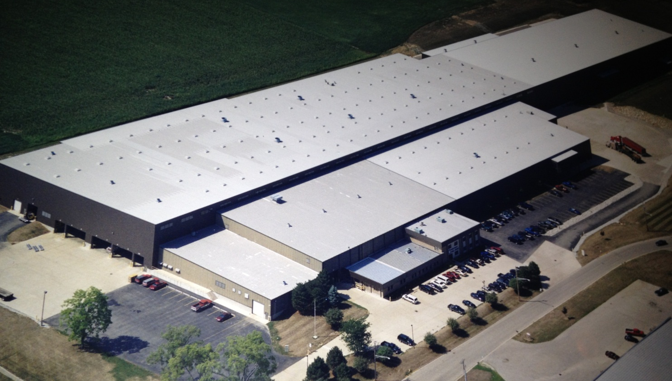

Our Facility
320,000 Square Foot
Founded: 1983
Employees: 134
Location: Piqua, OH (15 miles north of Dayton, OH)

Slide 3
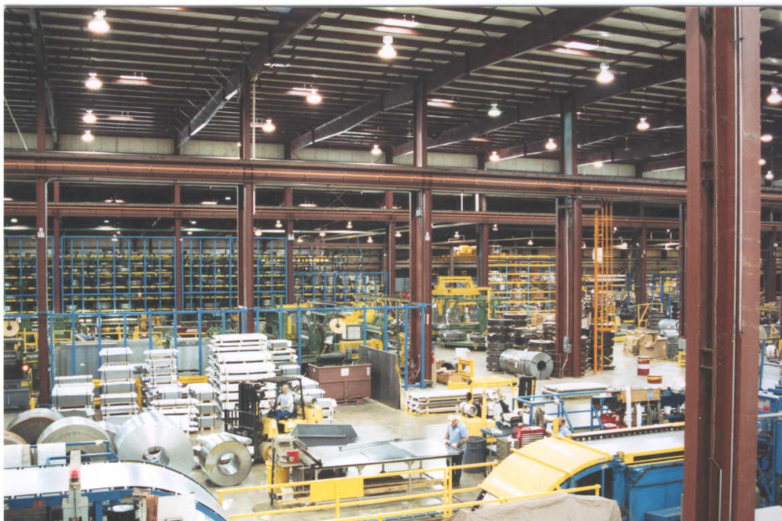
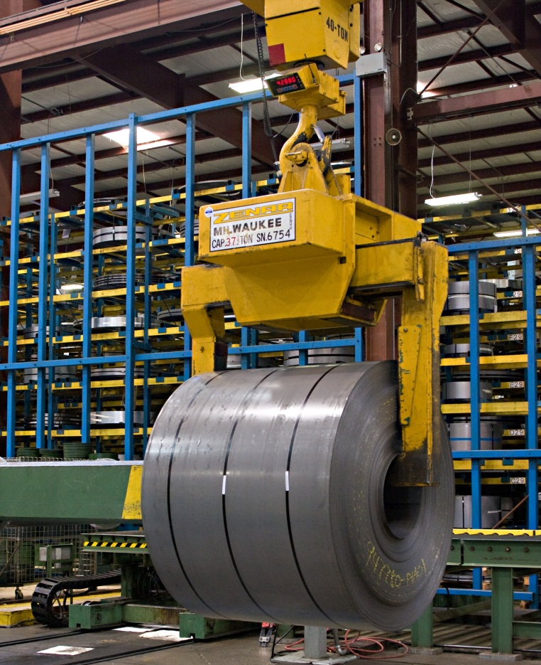
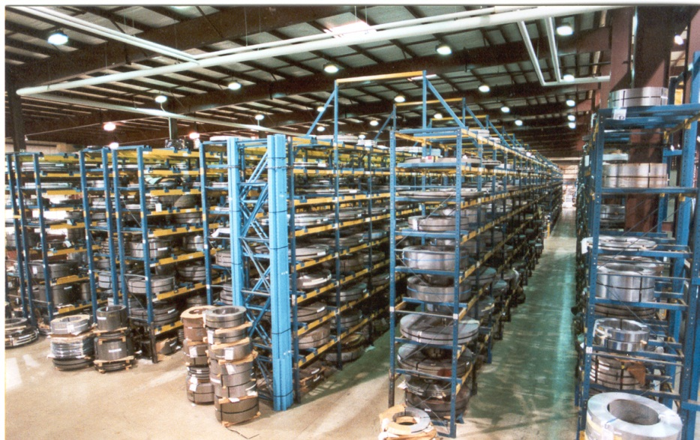
Plant Overview

Slide 4
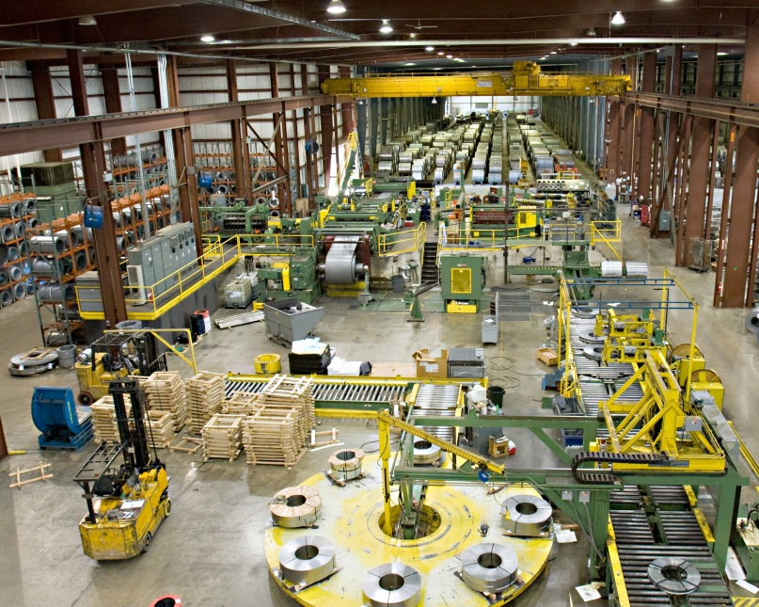
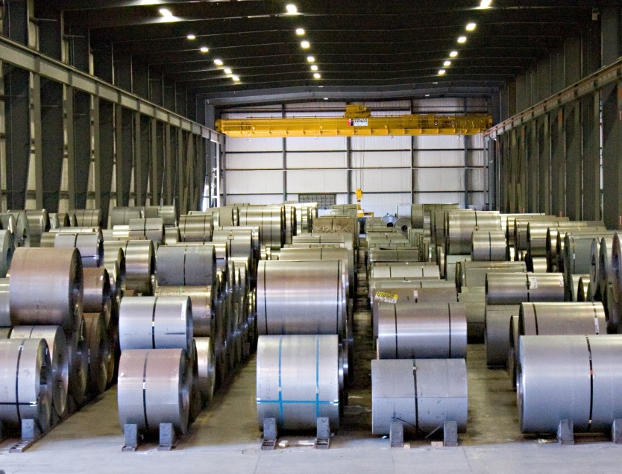
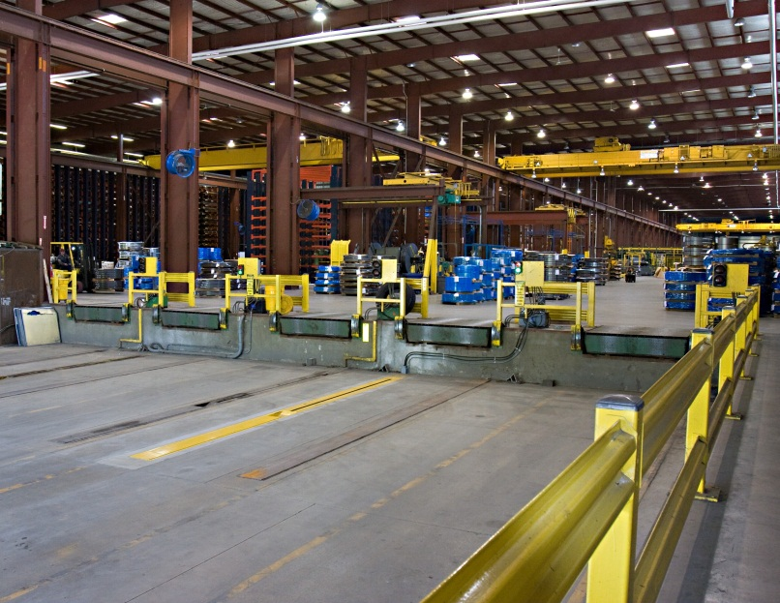
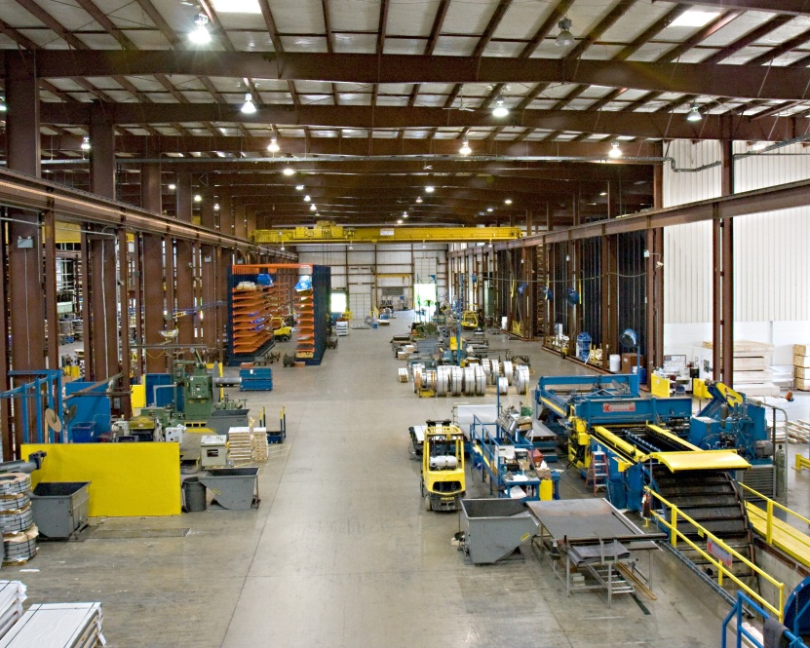
Plant Overview

Slide 5
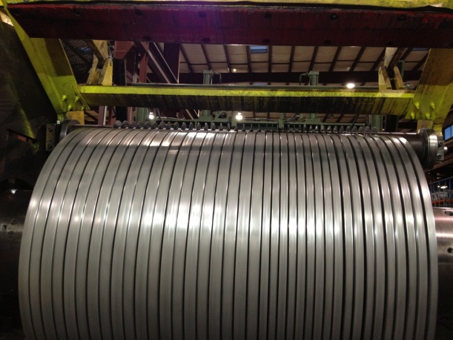
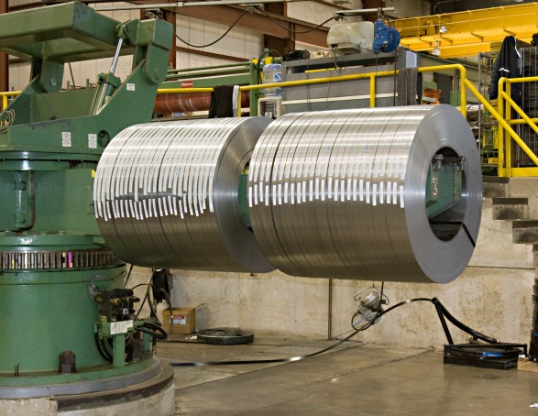
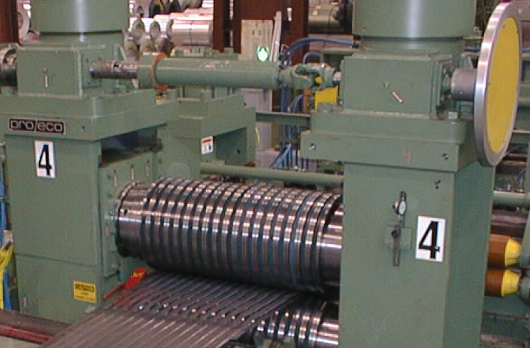
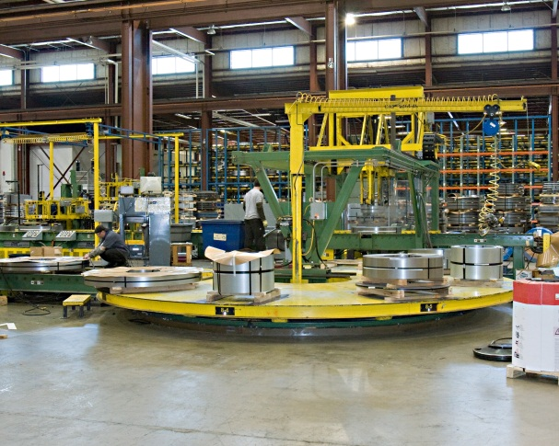
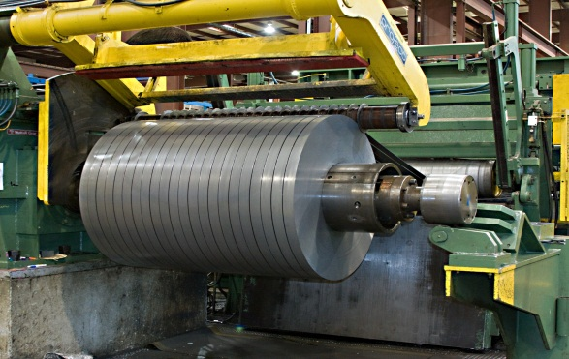
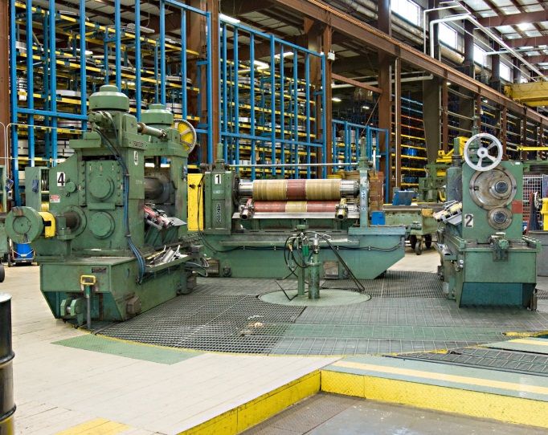
Heavy Gauge Slitting
PRO-ECO SLITTING LINE
A heavy gauge slitter with the following capabilities:
Gauge: .042” to .312”
Width / Max Weight: up to 72” wide / 90,000 lbs.
4 slitting heads

Slide 6
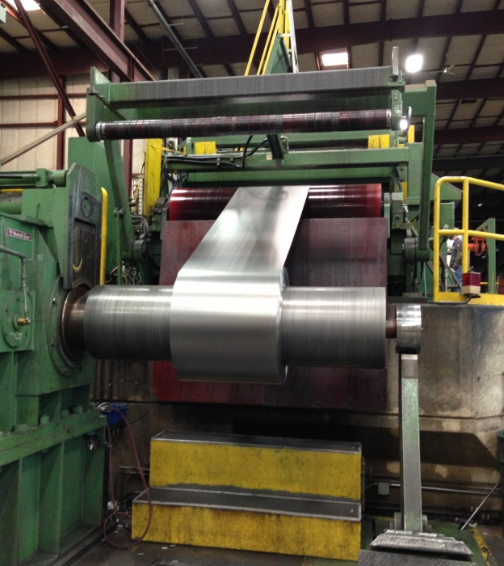
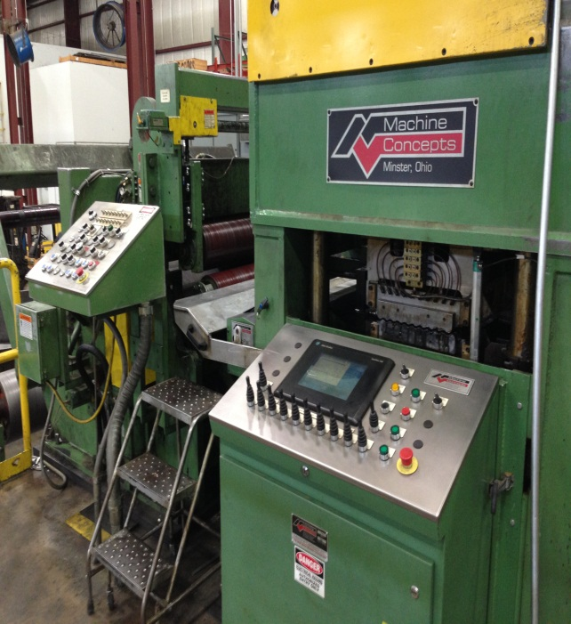
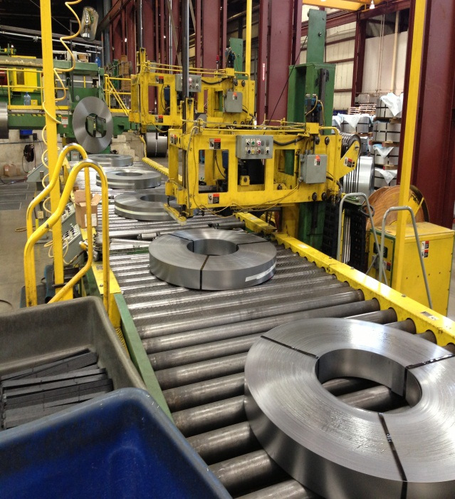
Light Gauge Slitting
HERR-VOSS / STAMCO SLITTING LINE
A light gauge slitter with an automatic correction leveler with the following capabilities:
Gauge: .012” to .135”
Width / Max Weight: up to 84” wide / 80,000 lbs.

Slide 7
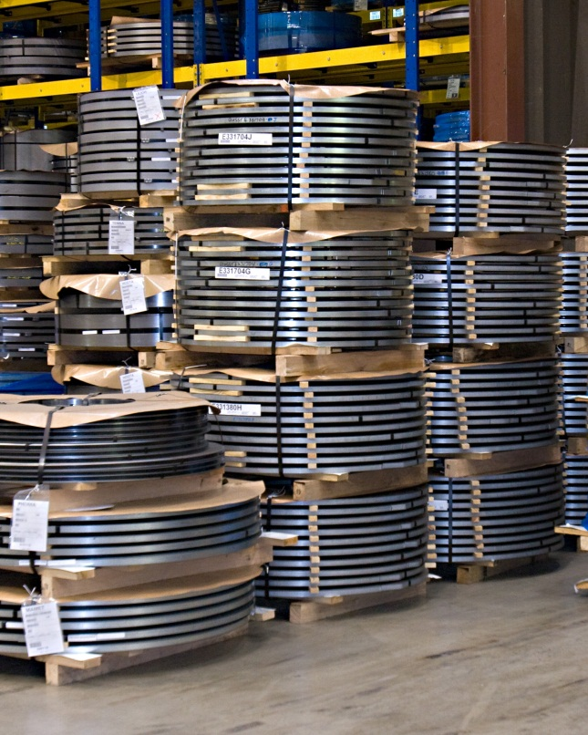
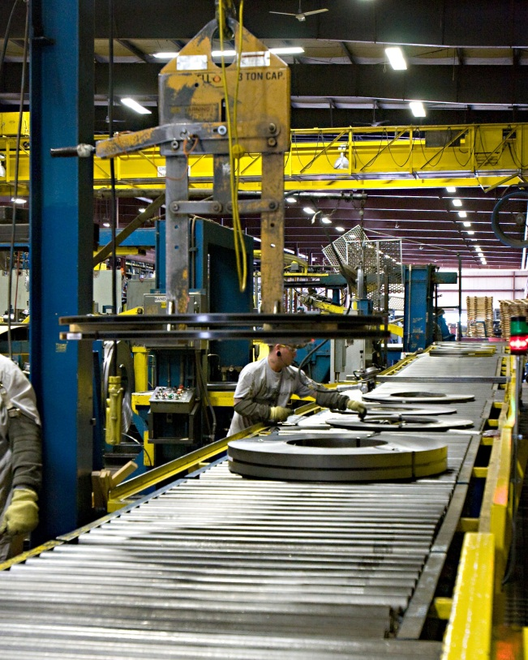
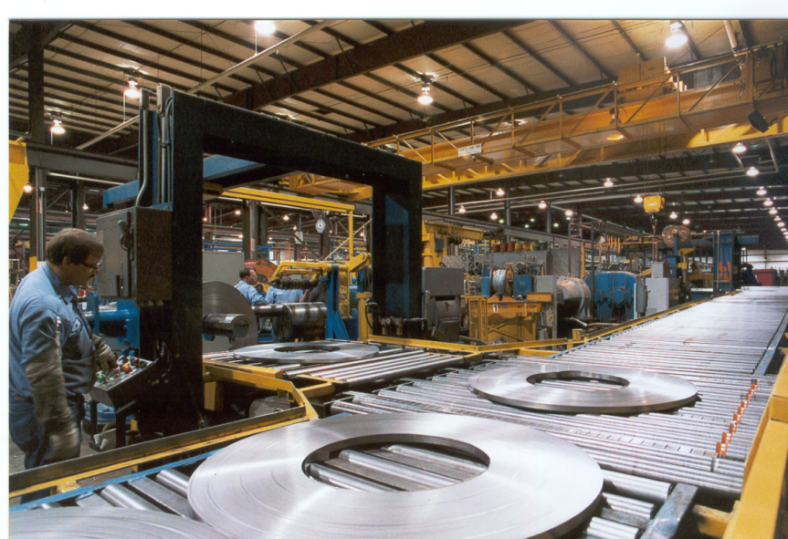
Narrow Slitting
NARROW SLIT COIL
Four narrow slitting lines
Gauge: .010” to .250”
Width: .375” to 36” wide

Slide 8
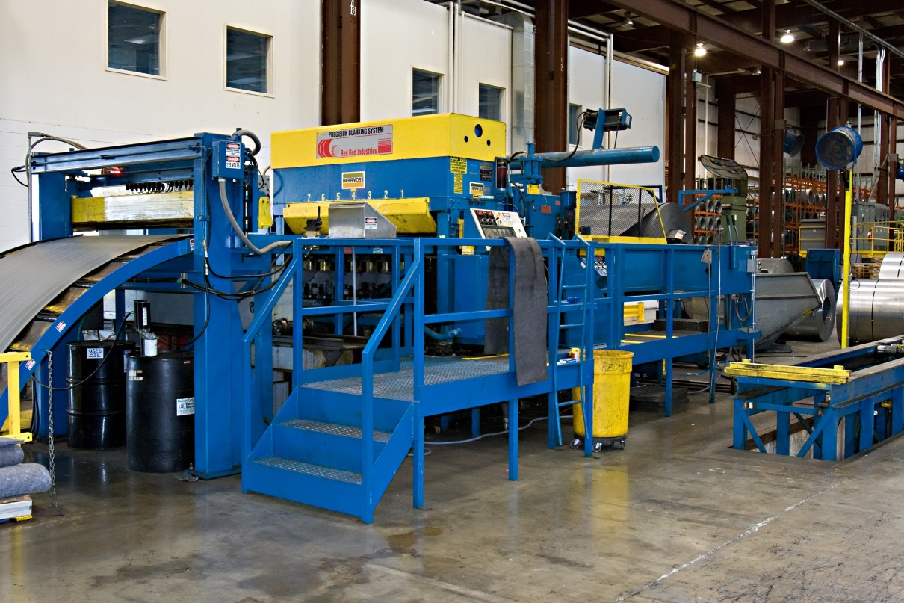
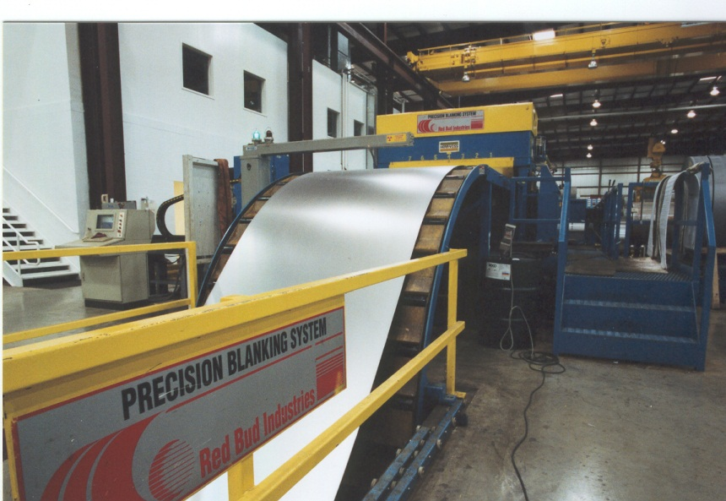
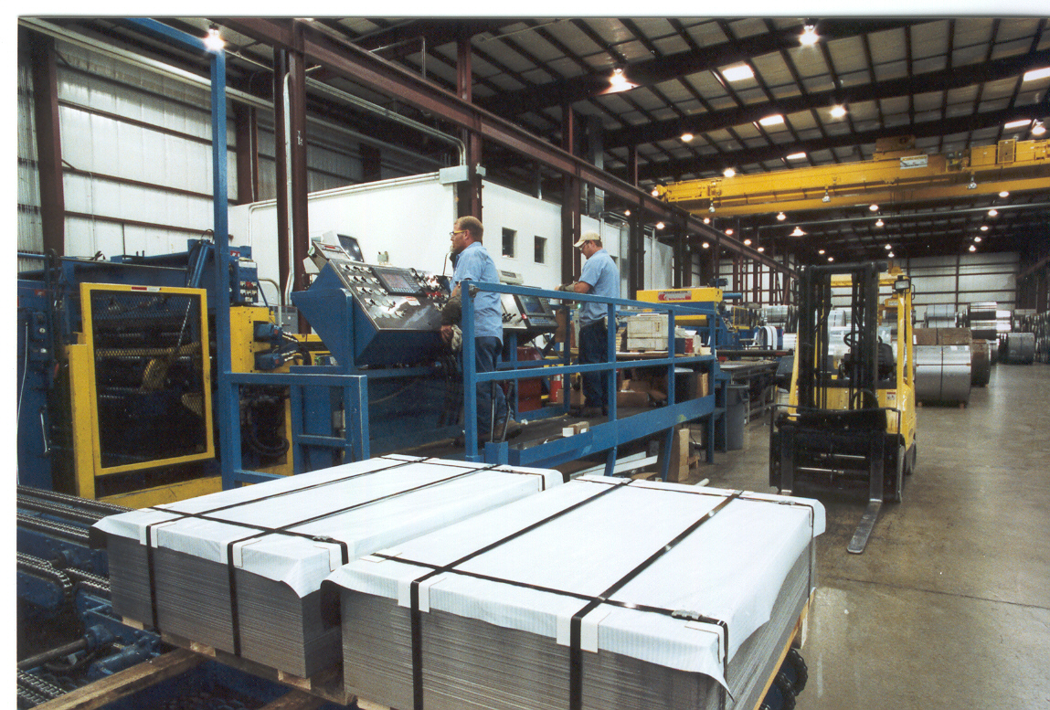
Red Bud Sheeting Line
RED BUD LINE W/ HERR VOSS LEVELER
A precision, multi-blanking, cut-to-length line
with the following capabilities:
Gauge: .020” to .135”
Width: up to 72” wide
Lengths: from 12” - 144” (Inquire on lengths over 144”)

Slide 9
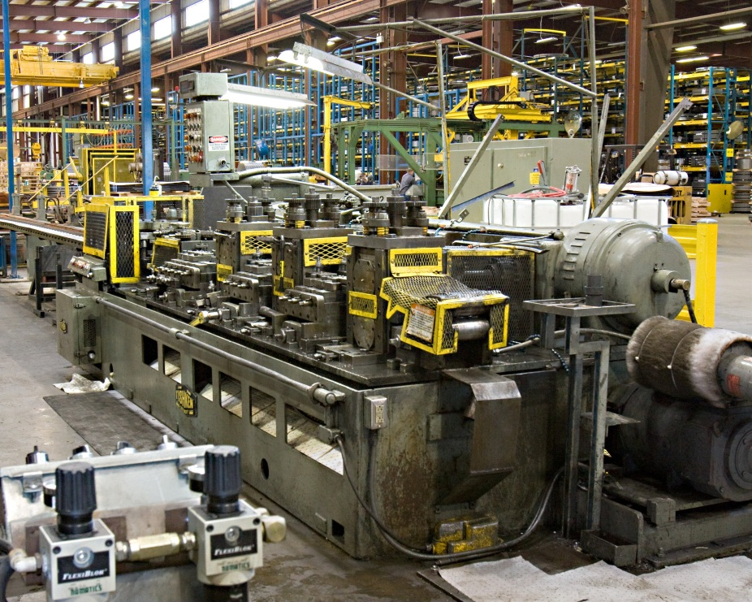
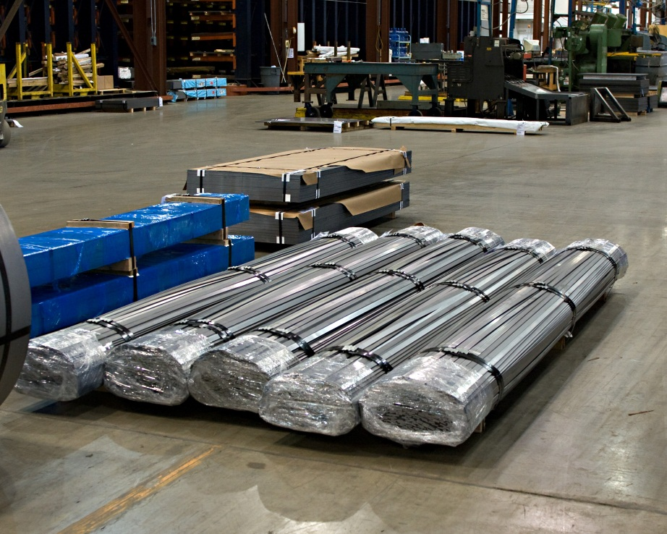
Cut to Length Bar
FLAT BAR STOCK
Tishken Edging & cut to length line
Gauge: 016” to .312”
Width: .625” to 6”
Lengths: up to 24 feet

Slide 10
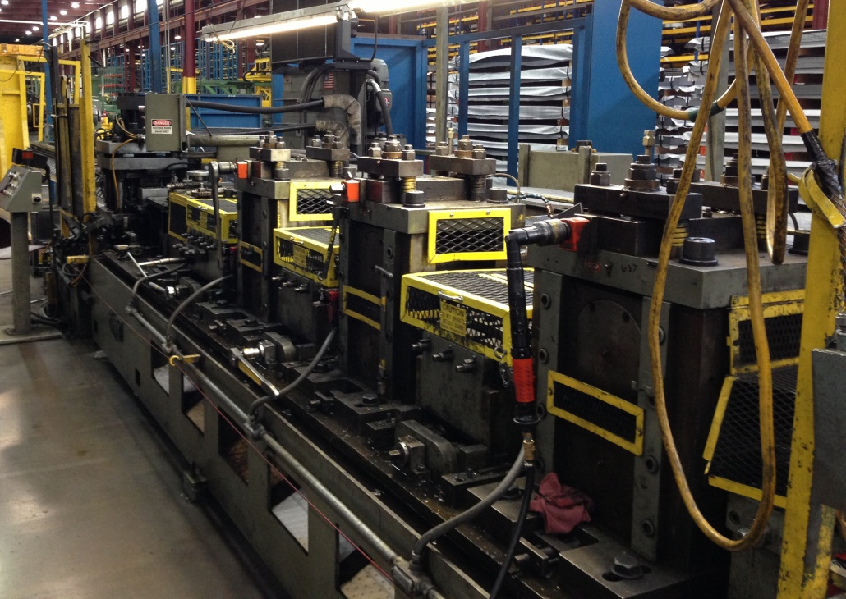
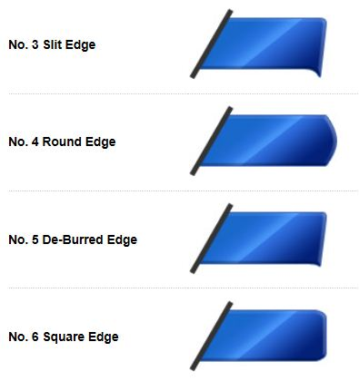
Edge Conditioned Coil
Edge Types Provided:
EDGE CONDITIONED COIL:
Gauge: .032” to .250”
Width: .500” to 10” (above .128” up to 4” wide)

Slide 11
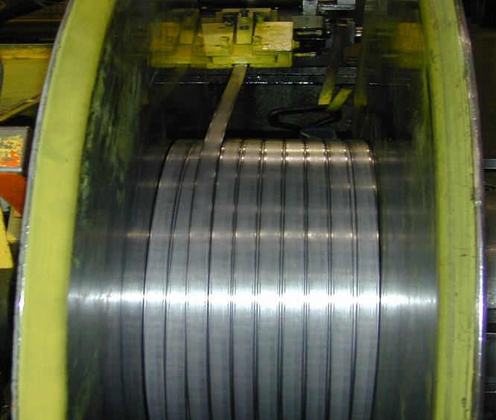
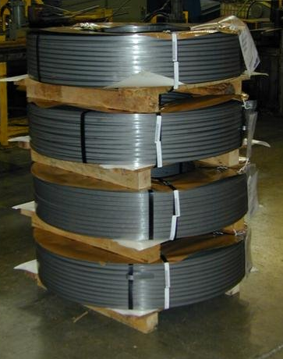
Oscillated Edged Coil
OSCILLATED EDGED COIL:
Gauge: .050” to .250”
Width / Max Weight: .625” to 2” wide
4,500# max coil weight

Slide 12
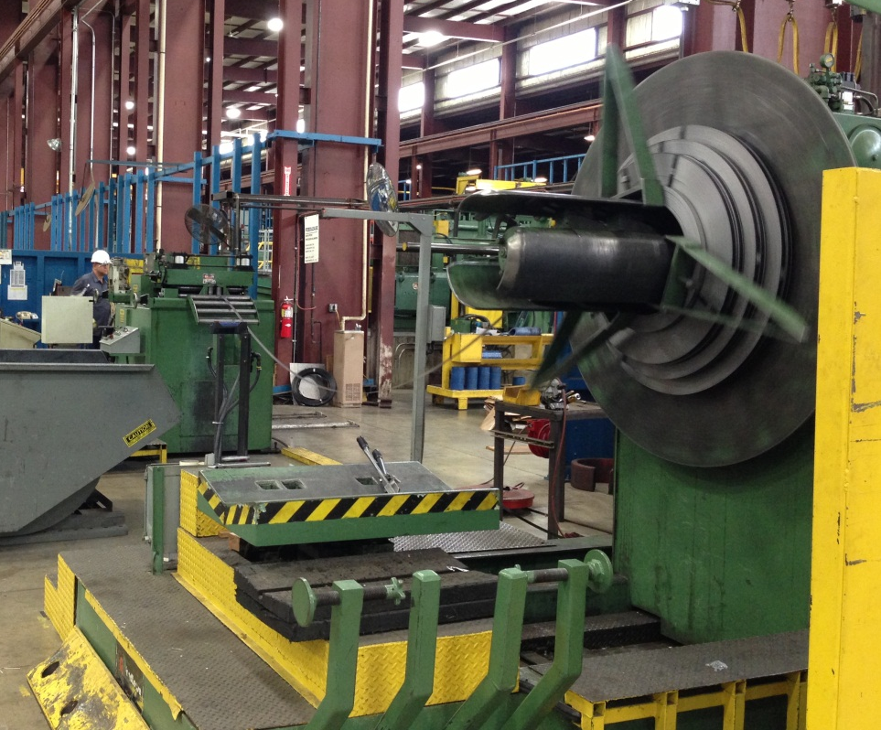
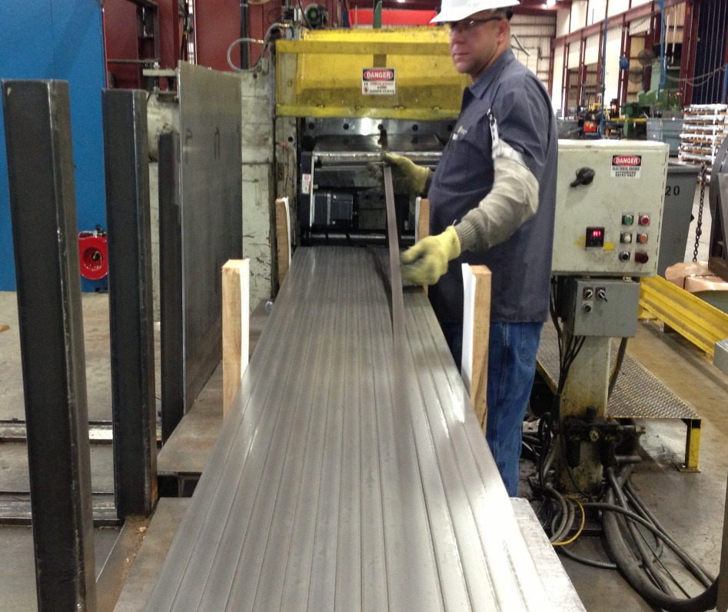
Cut to Length Line
24” FEEDLEASE HIGH SPEED PRECISION BLANKING LINE
Gauge: .010” to .125”
Width: .500” - 24” wide
Lengths: from .500” - 145”

Slide 13
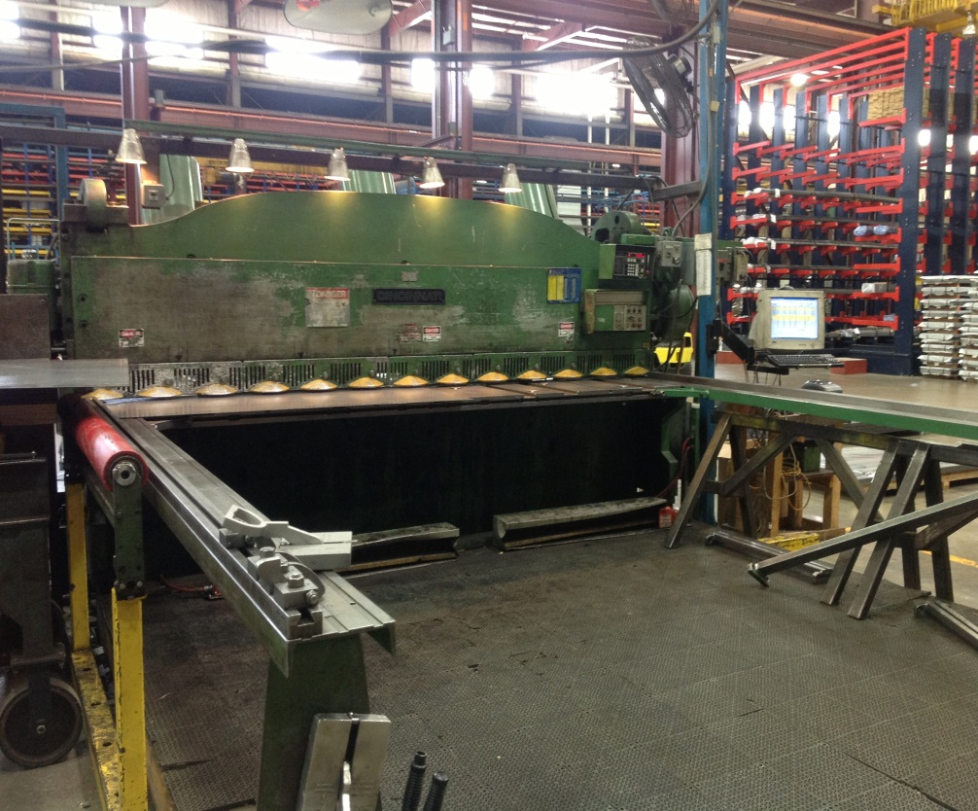
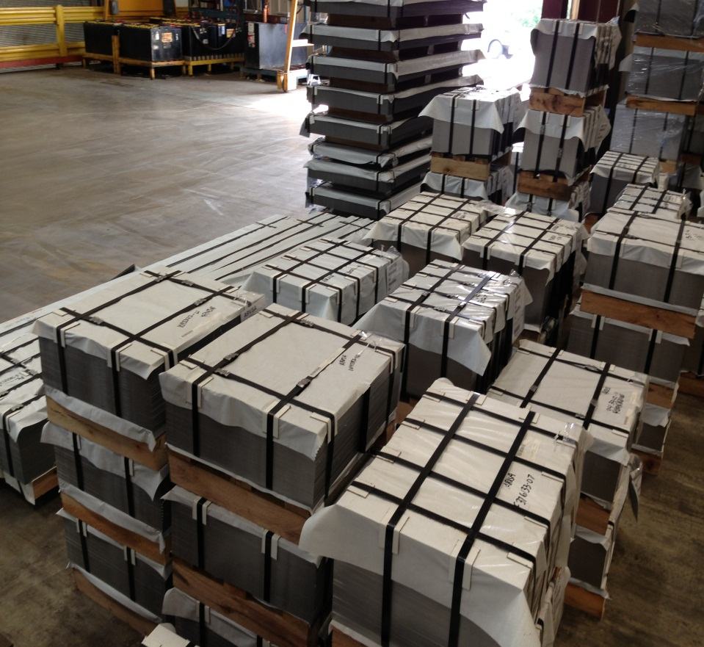
Re-squared Blanks
RESQUARED BLANKS
Three hand shears
Gauge: 016” to .312”
Lengths: up to 12 feet

Slide 14
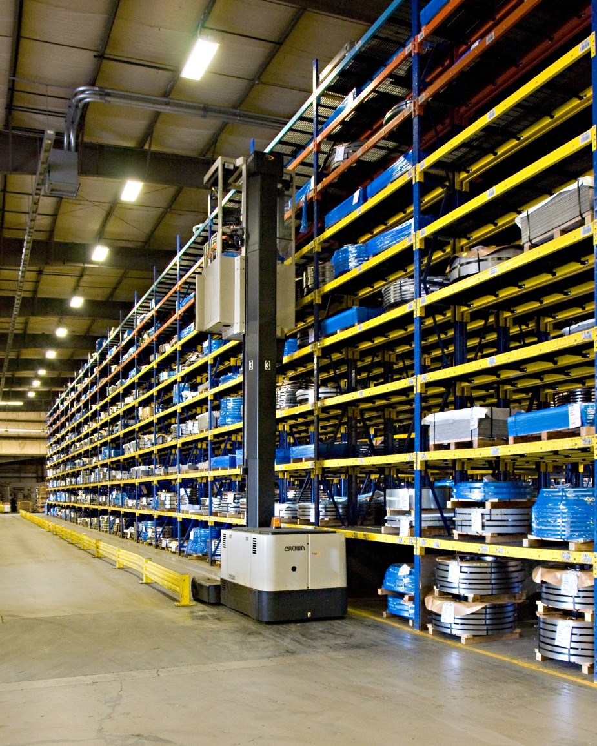
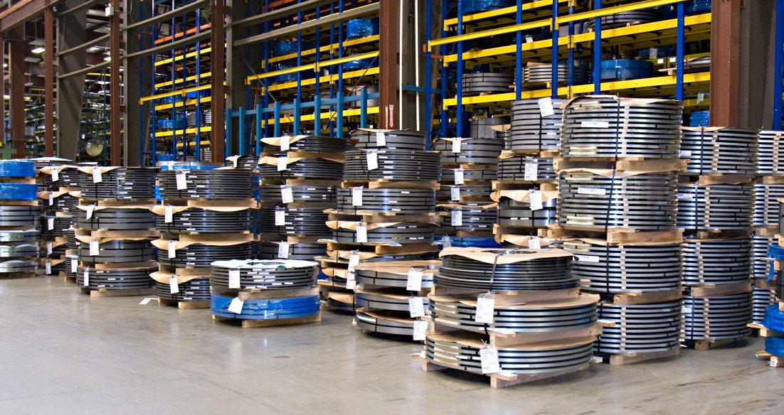
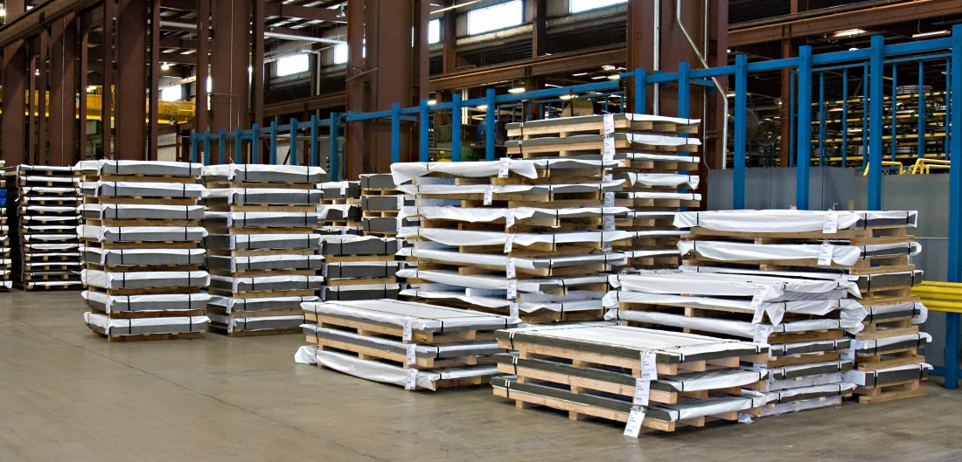
Inventory System

Slide 15
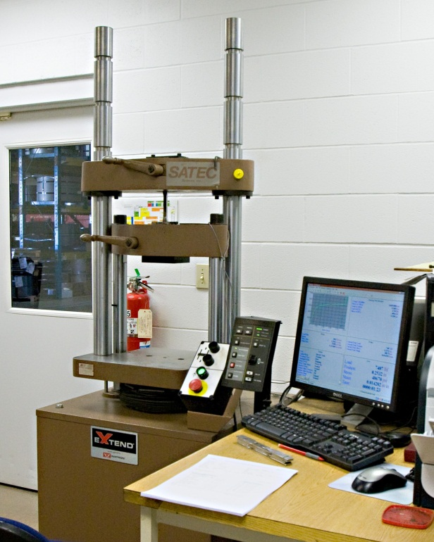
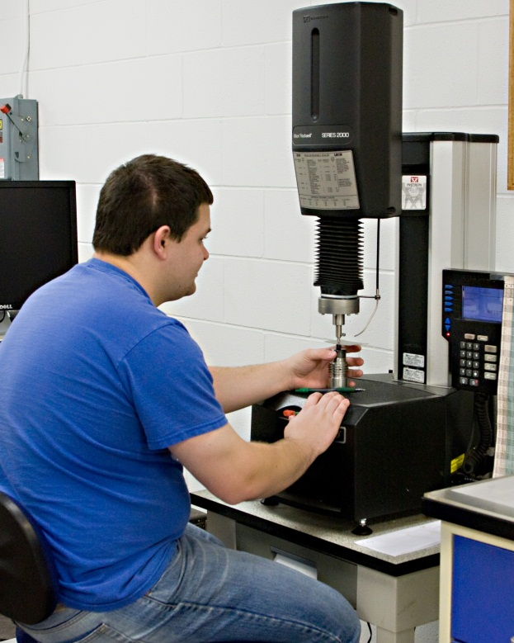
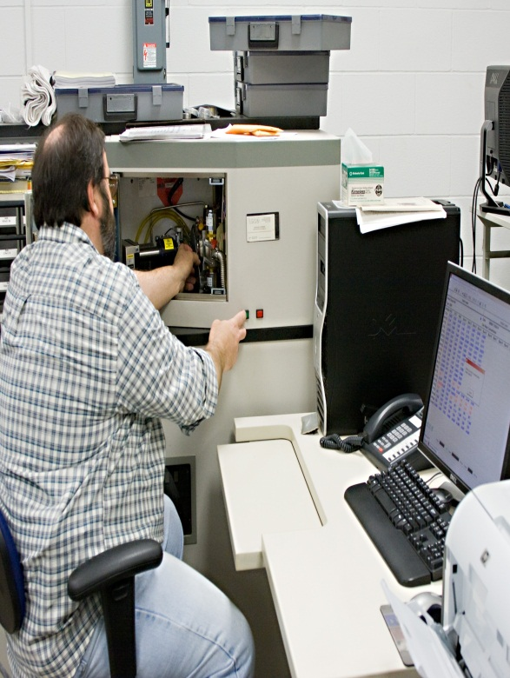
Metals Laboratory
Yield, Tensile, and
Elongation Testing
Rockwell Testing
Chemical Analysis

Slide 16
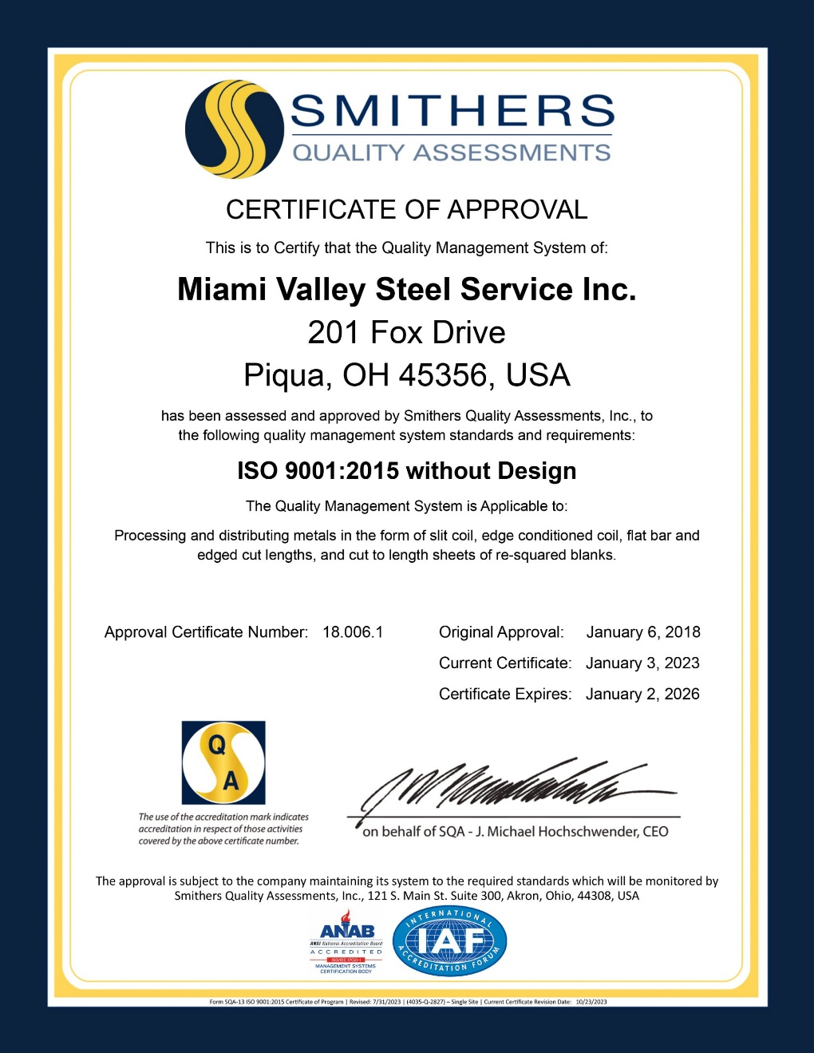
Quality Certification

Slide 17
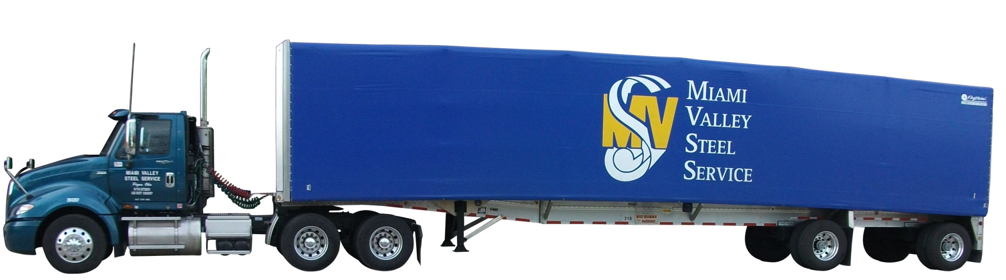
Shipping
Eight in house delivery trucks
50,000 lb net hauling capacity
GPS tracking

